Slide 1
Dijkstra Algorithm

Slide 2

OUTLINE
Introduction Dijkstra Algorithm
Key Concepts
Algorithm Steps
Limitations
Time & Space Complexity
Activity
Comparison with Other Algorithms
Applications

Slide 3
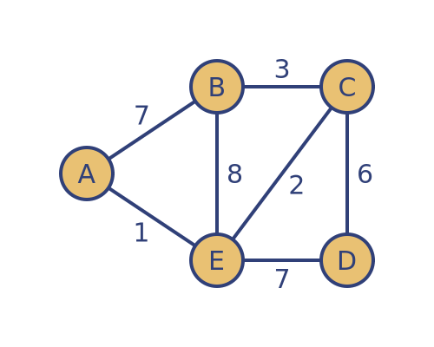
What is Dijkstra’s Algorithm?
Dijkstra’s Algorithm is a greedy algorithm used to find the shortest path between a source node and all other nodes in a weighted graph (with non-negative weights).
Example: Think of Google Maps: You start at your home and want to reach all nearby locations with the least total travel distance. Dijkstra’s algorithm helps find the quickest route to each one.

Slide 4
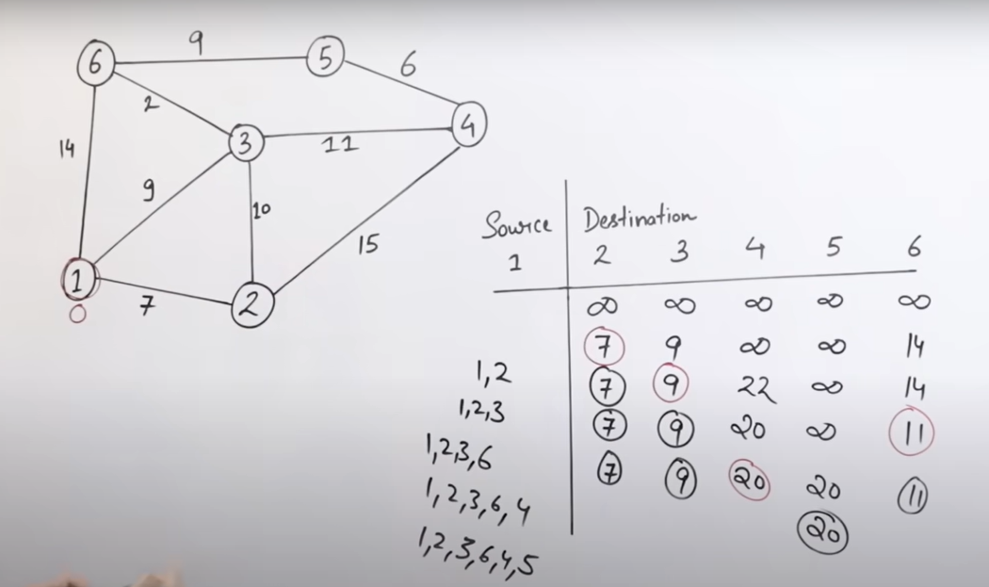

Slide 5
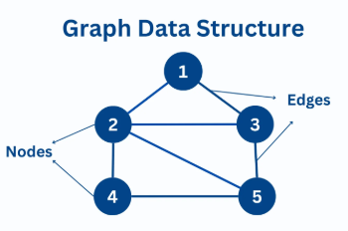
Key Concepts
1. Graphs (Nodes and Edges)
A graph is a data structure used to represent relationships between objects. It consists of:
Nodes (Vertices): The individual points or entities in the graph.
Edges: The connections (or relationships) between nodes.
Example: Imagine a map of cities.
Each city is a node.
Each road connecting the cities is an edge.

Slide 6
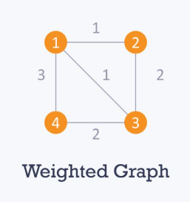
Key Concepts
2. Weighted Graph
A weighted graph is a graph where each edge has a numerical value (weight) associated with it, representing cost, distance or time.
Example: In the city map, if the road from City A to City B is 5 km, the edge has a weight of 5.

Slide 7
Key Concepts
3. Non-Negative Weights
In Dijkstra’s Algorithm, all edge weights must be zero or positive (non-negative). This ensures that the total cost/distance doesn't decrease when taking more steps.
Why Important? Dijkstra’s algorithm does not work correctly with negative weights.
Example: All road distances on a map (e.g., 2 km, 10 km) are non-negative.

Slide 8
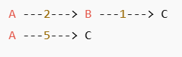
Key Concepts
4. Shortest Path
The shortest path is the route from a starting node to a destination node that has the least total weight (or cost).
Example:
Question: What is the shortest path from A to C?
Solution:
Path 1: A → C (Direct) = 5
Path 2: A → B → C = 2 + 1 = 3
So, the shortest path from A to C is: A → B → C with a total cost of 3.

Slide 9
Working Principle
The algorithm works by assigning a tentative distance value to every node:
Zero for the initial node and infinity for all others.
It then visits the unvisited node with the smallest tentative distance, updating neighboring nodes and repeating the process.

Slide 10
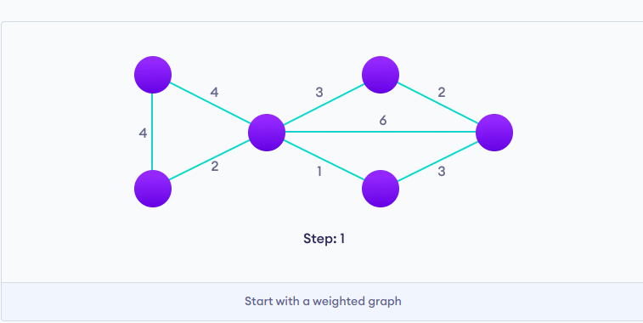
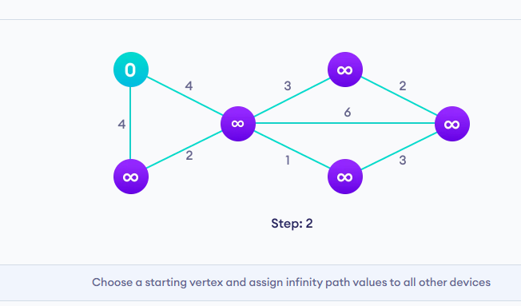
Algorithm Steps

Slide 11
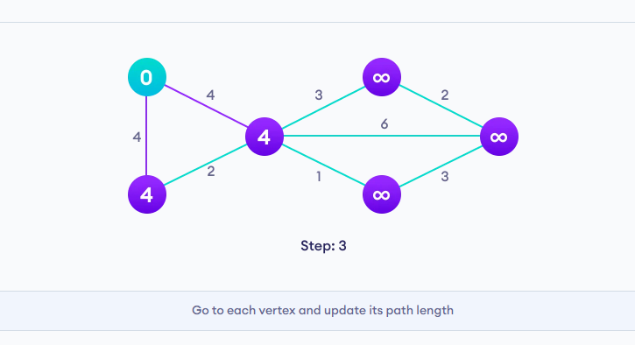
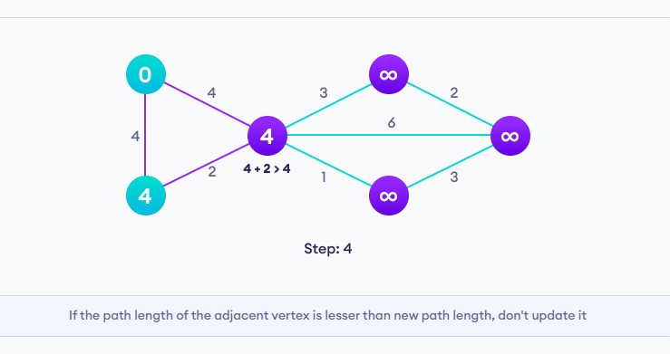
Algorithm Steps

Slide 12
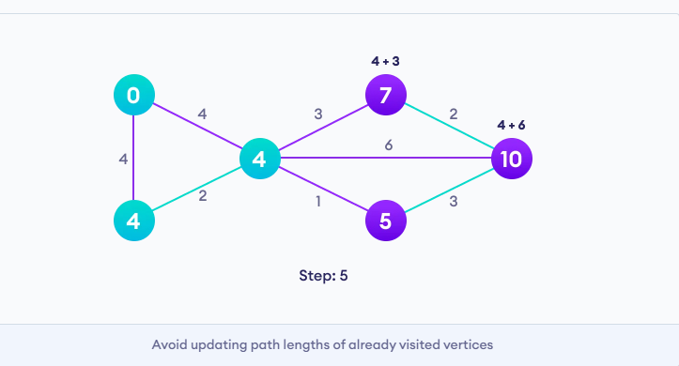
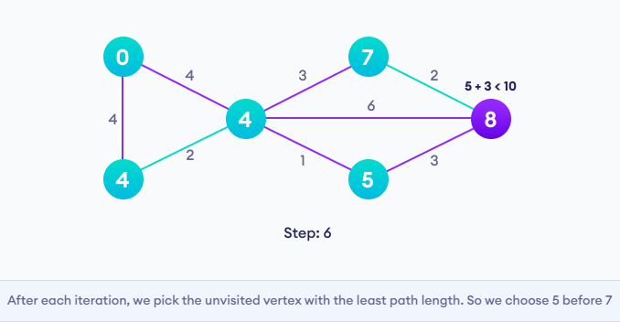
Algorithm Steps

Slide 13
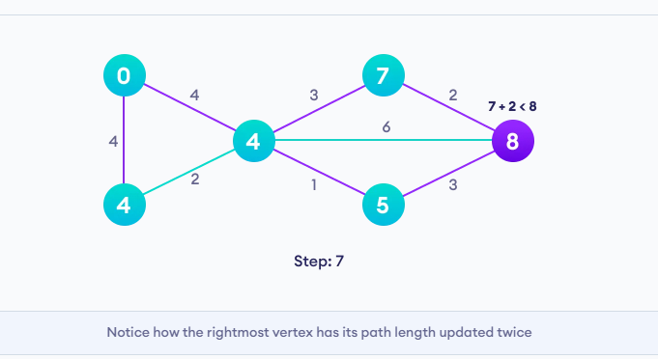
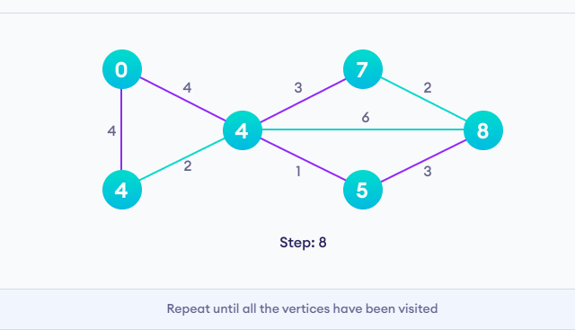
Algorithm Steps

Slide 14
Algorithm Steps
Initialization:
Set the distance of the source node to 0.
Set the distance to all other nodes as infinity.
Use a priority queue or min-heap to select the next closest node.
Visit Unvisited Nodes:
Pick the node with the smallest tentative distance.
Update the distances of its neighbors.
If the new distance is smaller, update it.

Slide 15
Algorithm Steps
Mark Node as Visited:
Once a node's shortest distance is known, mark it as "visited" (don't update it again).
Repeat until all nodes are visited or shortest paths are found.

Slide 16
Limitations
Doesn’t work with negative weight edges.
Becomes less efficient with very large graphs.
Needs to recalculate from scratch if the graph changes.
Not suitable for dynamic or real-time changing networks.

Slide 17
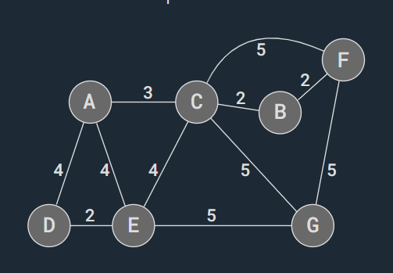
Activity

Slide 18
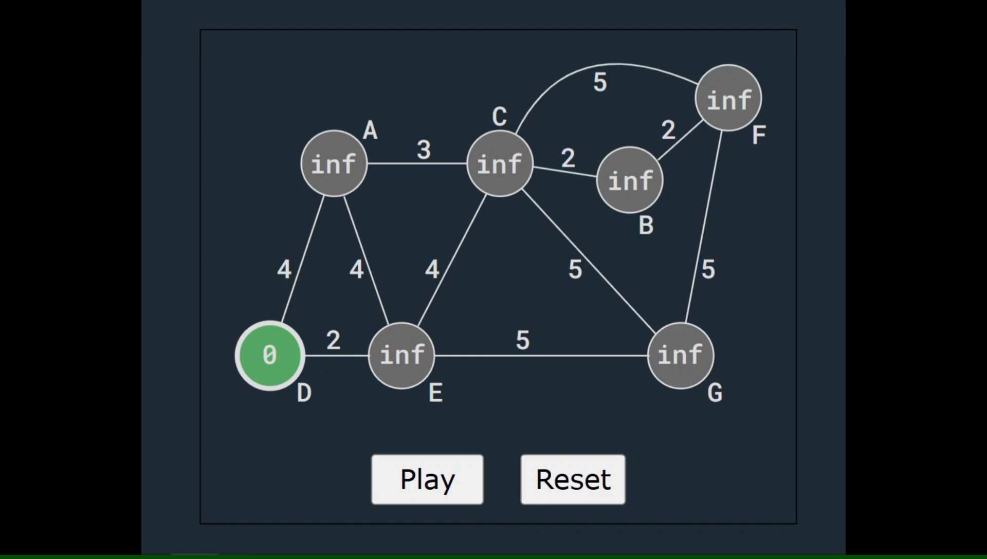
Simulation

Slide 19
Comparison with Other Algorithms
Dijkstra vs Bellman-Ford
Feature | Dijkstra | Bellman-Ford
Negative Weights | Not allowed | Allowed
Time Complexity | O((V + E) log V) (Faster) | O(V * E) (Slower)
Edge Relaxation | Greedy (priority queue) | Repeats edge relaxation V-1 times
Efficiency | Faster | Slower, but more flexible
Detects Negative Cycles | No | Yes
Use Case | Road maps, networks (non-negative) | Currency exchange, graphs with losses

Slide 20
Comparison with Other Algorithms
Dijkstra vs A* (A-Star) Algorithm
Feature | Dijkstra | A* Algorithm
Heuristic Function | Not used | Uses heuristic to estimate distance
Best For | General shortest path | Shortest path with goal direction
Performance | Slower on large maps | Faster due to informed search
Time Complexity | O((V + E) log V) | O(E) with good heuristics
Goal-Awareness | Explores all directions equally | Moves toward goal
Use Case | GPS systems, network routing | Game AI, maps with known target location
* estimate, not the actual cost

Slide 21
Applications
GPS Navigation Systems:
To find the shortest or fastest route between two geographical locations.
Network Routing Protocols
To find the most efficient route for data packets.
Robot Path Planning
Robots or autonomous vehicles use it to find the shortest path to reach a target location.
Game Development
In-game characters or objects find the shortest or most efficient path to a target.
Supply Chain Optimization
To reduce delivery time and transportation costs.

Slide 22
Time & Space Complexity
Time Complexity: O((V + E) log V)
Space Complexity: O(V)

Slide 23
Space Complexity
Space Complexity: O(V)
Distance array: Stores shortest distance to each node → O(V)
Visited: Stores visited nodes → O(V)
Priority queue: Holds up to V nodes → O(V)

Slide 24
Time Complexity
Time Complexity: O((V + E) log V)
V = number of vertices (nodes)
E = number of edges (connections)

